Slide 1
Python For Beginners
Presenter: Dhiraj Kafle
BSc. CSIT, Tribhuvan University
Software Engineer

Slide 2
Setting up Python:
(In Windows Operating System)
First need to install ‘virtualenv’, (if not already installed in the OS)
⇒ pip install virtualenv
Now, we can create python virtual environment.
⇒ virtualenv envname
eg: virtualenv python_env
Finally, activate the environment.
⇒ envname\scripts\activate
eg: python_env\scripts\activate

Slide 3
Setting up Python:
(In Linux/Mac Operating System)
First need to install python-venv ( if not already installed in the OS)
⇒ sudo apt install pythonversion-venv
eg: sudo apt install python3.10-venv
Now, we can create python virtual environment.
⇒ python3 -m venv envname
eg: python3 -m venv python_env
Finally, activate the environment.
⇒ source envname/bin/activate
eg: source python_env/bin/activate

Slide 4
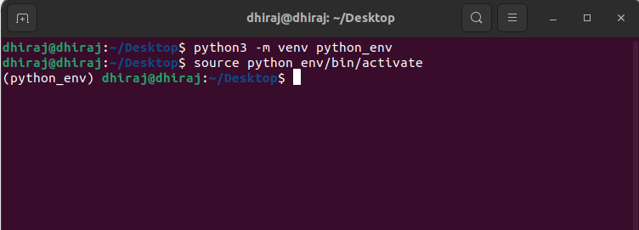

Slide 5
Python Basics
Data Types and Variables
Operators
Type Casting / Type Conversion
Data Structures
A. List
B. Tuples
C. Sets
D. Dictionary
Conditional Statements
Loops
Functions (Lambda Functions)
Decorators and Generators

Slide 6
Primary(Basic) Data Types
Int (Integers) ⇒ eg: 2, 1000, 0, -5 etc
Float ⇒ Floating point/decimal numbers. eg: 2.75, -4.99
Complex ⇒ Complex numbers. eg: 3 + 4j, 5 - 2j
Boolean ⇒ Represents truth/binary values. eg: True or False
String ⇒ Sequence of text characters. eg: ‘dhiraj’, “Python”
NonType ⇒ Represents absence of a value. eg: None

Slide 7
Variables Creation
NOTE: variables are used to store data / values.
Some variable creation examples:
first_name = "Dhiraj"
last_name = '''Kafle'''
a = 2
b = 5.6478
C = True
d= None

Slide 8
Operators
### Assignment Operator (i.e =) :
a = 34
a -= 12
print(a)
a += 12
a /= 2
print(a)

Slide 9
## Arithmetic Operators :
Operation | Operator | Example
Addition | + | 9 + 3 = 12
Subtraction | - | 9 - 3 = 6
Multiplication | * | 9 * 3 = 27
Division | / | 9 / 3 = 3
Floor Division | // | 7 // 3 = 2

Slide 10
### Bitwise Operators :
# bitwise and operation
a = 7
b = 6
print(a & b)
# bitwise or operation
a = 7
b = 7
print(a | b)
# bitwise negation operation
c = 10
print(~(c))

Slide 11
### Comparison Operator :
b = (14 <= 7)
print(b)
b = (14 >= 7)
print(b)
b = (14 < 7)
print(b)
b = (14 > 7)
print(b)
b = (14 == 7)
print(b)
b = (14 != 7)
print(b)

Slide 12
### Identity Operator:
# It is used to compare the memory location of two or more variables
a = 100
b = 100
result = a is b
print(result)

Slide 13
Type Casting / Type Conversion
## Implicit Type Conversion (on basis of hierarchy):
num_int = 123
num_flo = 1.23
num_new = num_int + num_flo
print("datatype of num_new:", type(num_new))
NOTE: Hierarchy of float is higher than integer.

Slide 14
Explicit Type Conversion
## Float to integer and also Integer to Float :
a = 2
b = 4.0
converted_a = float(a)
converted_b = int(b)
sum = converted_a + converted_b
print("sum", sum)
print("Data type of sum", type(sum))

Slide 15
Explicit Type Conversion
## String to integer :
d = "47"
converted_d = int(d)
print(type(converted_d))
## Integer to String :
e = 47
converted_e = str(e)
print(type(converted_e))

Slide 16
Data Structures
Data Structure is a special format/ way to store data in a computer so that it can be used/retrieved efficiently.
## Various Data Structures in Python:
List
Tuples
Sets
Dictionary
NOTE: NOTE: All above data structure’s size can be dynamic in python.

Slide 17
List
NOTE: List size can be dynamic.
NOTE: List are mutable (items in the list can be changed/deleted).
## SYNTAX for creating empty list:
first_list = []
second_list = list()
## Creating list with items of different types:
c = [47, "Engineer", False, 6.9]

Slide 18
List Comprehension
NOTE: List comprehension in Python is a concise way to create a new list.
NOTE: It also provide a more readable and often faster alternative to using traditional for-loops.
## SYNTAX : [expression for item in list if condition]
## EXAMPLE:
number_list = [x for x in range(20) if x % 2 == 0]
print(number_list)

Slide 19
Tuples
NOTE: Tuples are immutable (meaning items in tuple cannot be changed/deleted).
## SYNTAX for creating empty tuple:
emptyTuple = ()
emptyTuple2 = tuple()
## Creating list with items of different types:
a = (1, 2, 3, "nepal", 3.4, 6, 9)
print(type(a))

Slide 20
Tuple Error Scenario
new_tuple = (1, 2, 3, 4, 5)
print(new_tuple)
# t[0] = 34 # throws an error # Cannot change/update the values of a tuple
NOTE: Tuples are immutable.

Slide 21
Dictionary
NOTE: A Python dictionary is a collection of key-value pairs.
Each key is unique, and it maps to a value.
## SYNTAX for creating tuple:
my_dict = {key: ‘value’}
new_dict = dict([(key, 'value')])
## Creating dictionary with items of different types:
myDict = {
"fast": "In a Quick Manner",
"dhiraj": "A Programmer",
"anotherdict": {'dhiraj': 'Player'}
}

Slide 22
Dictionary useful methods
## To access key, value pair of the dictionary
myDict.items()
## To only access keys of the dictionary
myDict.keys()
## To only access values of the dictionary
myDict.values()

Slide 23
Dictionary Comprehension
NOTE: Dictionary comprehension is an concise way to create a new dictionary from an iterable.
## Without using dictionary comprehension to find square
squares = {}
for x in range(6):
squares[x] = x * x
print(squares)
## Using Dictionary Comprehension to find square
squares = {x: x*x for x in range(6)}
print(squares)

Slide 24
Sets
NOTE: A set is an auto sorted collection of items.
NOTE: Every set element is unique (no duplicates).
NOTE: A set object does not support indexing.
## SYNTAX for creating empty sets
a = set()
## Creating set of various data types
my_set = {1.0, "Hello", (1, 2, 3)}

Slide 25
Conditional Statement
## If else
sub1 = int(input("Enter first subject marks\n"))
sub2 = int(input("Enter second subject marks\n"))
sub3 = int(input("Enter third subject marks\n"))
If (sub1 < 33 or sub2 < 33 or sub3 < 33):
print("You are fail because you achieved less than 33 in any one of the subjects")
elif (sub1 + sub2 + sub3) / 3 < 40:
print("You are fail because you achieved less than 40%")
else:
print("Congratulations ! Successfully Passed the exam.")

Slide 26
Conditional Statement
## `in` and `not in`
list1 = [46, 47, 48]
if 47 in list1:
print('you are the one’)
if 47 not in list1:
print('you are unknown’)

Slide 27
Loops
## for Loop
Note: Better to use for loop when you have a known set of items to iterate over or a definite range of values.
# Example
languages = [“C”, "C++", "Java", “Ruby", “PHP”, “Python”, "C#"]
for language in languages:
if language == "Python
print(language + " found.")
break
print("This line never executes")
print(language + ": is not the language what we are looking for.")

Slide 28
Loops
## using for loop with range
SYNTAX : for i in range(initialization, stop_at, increment)
Note: By default starts at 0, and increment by 1.
# Example 1
for i in range(11):
print("Iteration :", i)
# Example 2
languages = ["Python", "C++", "Java", "Perl", "C#"]
for i in range(len(languages)):
print(i, languages[i])

Slide 29
Loops
## while Loop
Note: Better to use a while loop when you need to keep iterating until a certain condition changes, and you don't know in advance how many iterations you'll need.
# Example :
response = input("Do you want to continue ? Y/N: ")
while response.lower() == "y":
response = input("Do you want to continue ? Y/N: ")
Note: In python there is no do while loop.

Slide 30
Functions / Methods
NOTE: Function is a block of reusable code that performs a specific task & u can define using ‘def’ keyword, followed by function name, parenthesis and colon.
# Example
def greet(name="ram"): ## Function Definition
if name == "ram":
return "Hi " + name + " ! Welcome."
print(greet()) ## Function call
NOTE: variables inside function definition parentheses are called parameters.
NOTE: variable inside function call parentheses are called arguments.

Slide 31
Lambda Function (one-line function)
NOTE: lambda function is a small anonymous function defined with the lambda keyword.
Lambda function does not include a “return” statement.
Syntax ⇒ lambda arguments: expression
## without using lambda function
def doubling(x):
return x * 2
print(doubling(10))
## Using lambda function
doubling = lambda x: x * 2
print(doubling(10))

Slide 32
Decorators
## Decorator is a function that accepts function as argument and also returns function
NOTE: allows you to modify/validate the behavior of any function
## EXAMPLE
def make_pretty(func): ## make_pretty() is a custom decorator function
def inner(): ## inner() / wrapper() function is automatically called
func()
return inner
@make_pretty ## decorators are implemented using the @ syntax followed by the decorator function
def ordinary():
print("Inside Ordinary Function")
ordinary()

Slide 33
OOP (Object oriented programming)
## class & objects
NOTE: A class is a blueprint for creating objects (instances).
NOTE: an object is an instance of a class.
NOTE: Generally, a class contains, attributes,constructor & custom methods/functions
NOTE: `self` parameter gives the reference of the specific instance
Example:
class Dog(): ## Class Definition
def __init__(self, naam) ## __init__ is the constructor / instance initializer
self.name = naam
def bark(self): ## bark() is a method of the class
print(self.name, 'is barking & his age is ', self.age)
puppy = Dog('Puppy') ## object / instance creation
puppy.bark() ## calling bark() method using object

Slide 34
Class variable
Note: A class variable is a variable that is shared by all instances (objects) of a class.
Note: Class variables are defined within the class definition but outside of any instance methods/constructor.
Example:
class Employee:
Num_of emps = 0 ## Num_of_emps is a class variable
def __init__(self, first, last, pay, raise_amout= None):
self.first = first
self.last = last
Employee.num_of_emps += 1 ## using class variable
def fullname(self):
return '{} {}'.format(self.first, self.last)

Slide 35
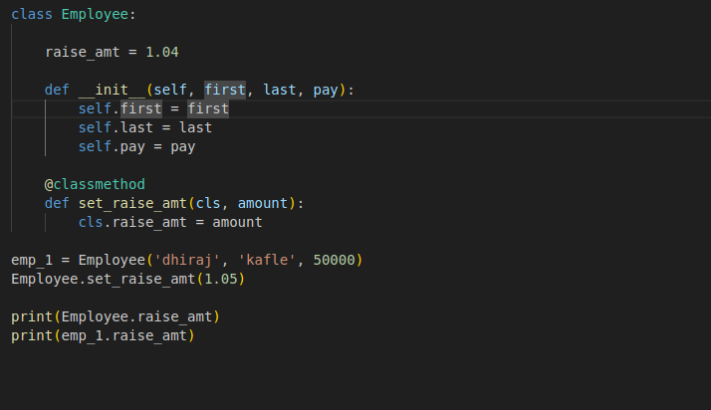
Methods
@classmethod ⇒ if only want to access the class attribute/variable

Slide 36
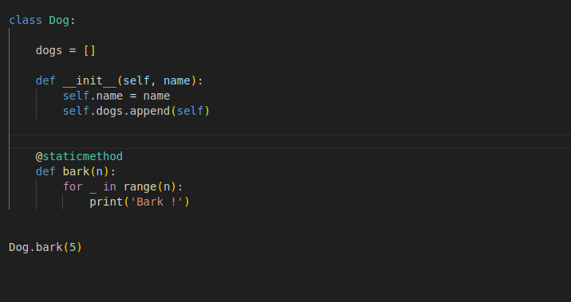
Methods
@staticmethod ⇒ if you never need to access class variable nor constructor attributes

Slide 37
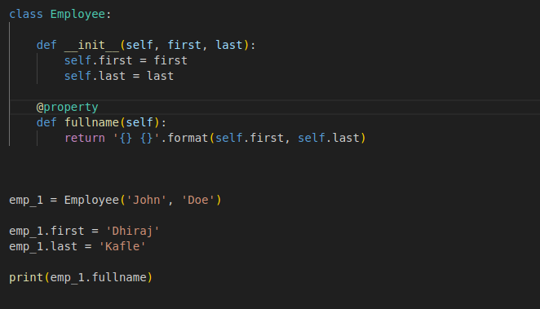
@property decorator
@property ⇒ allows you to define a `method/function` that can be accessed like an `attribute`.

Slide 38
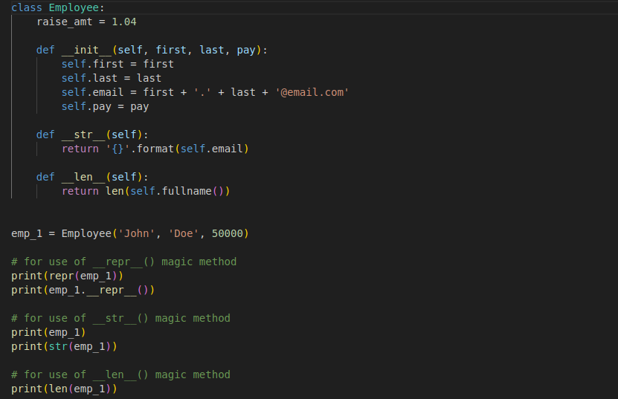
Magic / Dunder Method
It allow customization of how objects behave in various contexts, like initialization, printing, representation, and arithmetic operations.

Slide 39
Inheritance
Inheritance allows one class (subclass to inherit & extend the properties and methods of another class(parent).
Python supports various types of following inheritance:
Single Inheritance
Multiple Inheritance
Multilevel Inheritance
Hybrid Inheritance

Slide 40
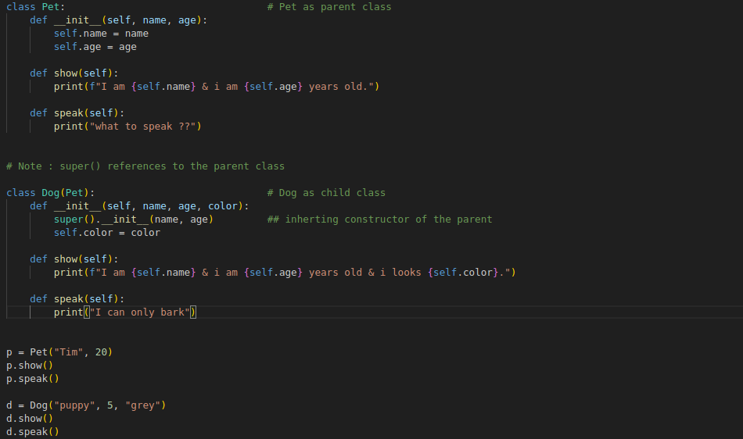
Single Inheritance ⇒ a child class (subclass) inherits from a single parent class (superclass)

Slide 41
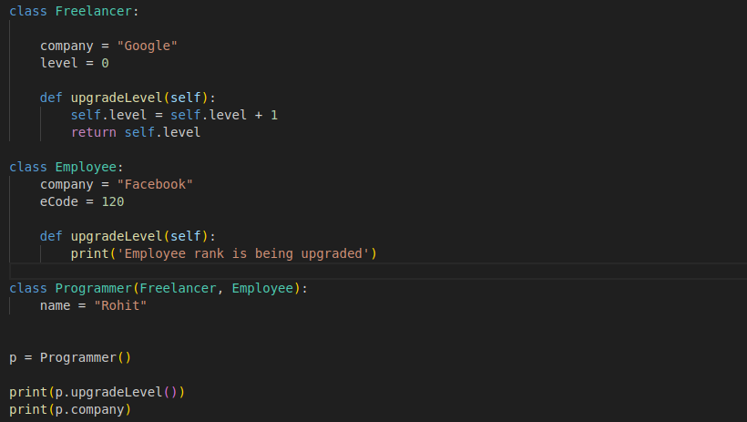
Multiple Inheritance ⇒ a child class (subclass) inherits from a multiple parent class (superclass)

Slide 42
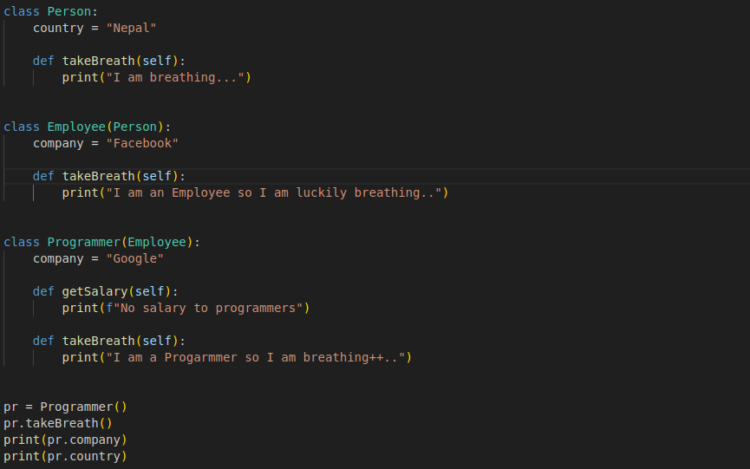
Multilevel Inheritance ⇒ A class serves as a base class for another class, which in turn serves as a base class for yet another class.

Slide 43
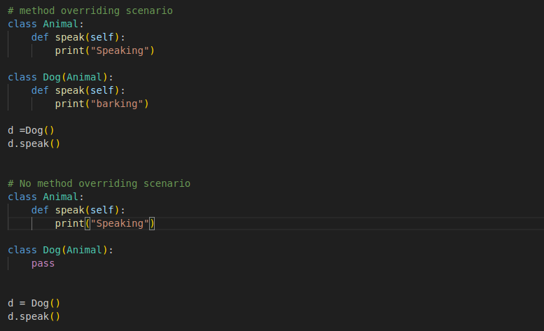
Method overriding
It allows a child class to override the implementation of a method that is already defined in its superclass/parent.
Note:Always higher priority for child class method implementation, if not found, then only looks for the method on super class.

Slide 44
Thank You !!

